Slide 1
IMPORT PASCAL VOC
Import original and custom Pascal VOC datasets to Supervisely

Slide 2
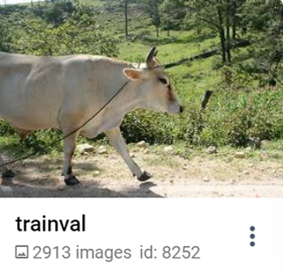
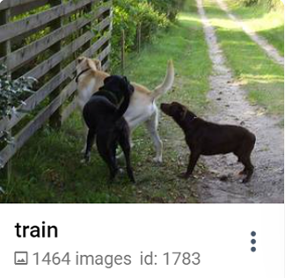
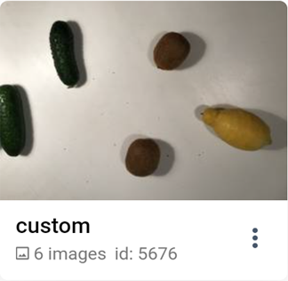
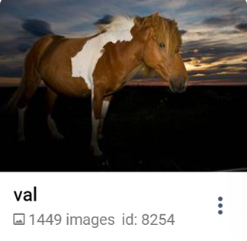
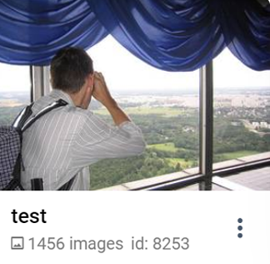
IMPORT
PASCAL VOC
Import original and custom Pascal VOC datasets to Supervisely

Slide 3
IMPORT PASCAL VOC
Import original and custom Pascal VOC datasets to Supervisely

Slide 4
IMPORT PASCAL VOC
Import original and custom Pascal VOC datasets to Supervisely

Slide 5
OUR COMPANY
Mercury is the closest planet to the Sun and the smallest one in the Solar System—it’s only a bit larger than the Moon. The planet’s name has nothing to do with the liquid metal since it was named after the Roman messenger god
LOGO

Slide 6
TABLE OF CONTENTS
01
Market analysis
03
Goal & strategy
02
Content plan
04
Kpi overview
You can describe the topic of the section here
You can describe the topic of the section here
You can describe the topic of the section here
You can describe the topic of the section here

Slide 7
01.
MARKET ANALYSIS
You can enter a subtitle here if you need it

Slide 8
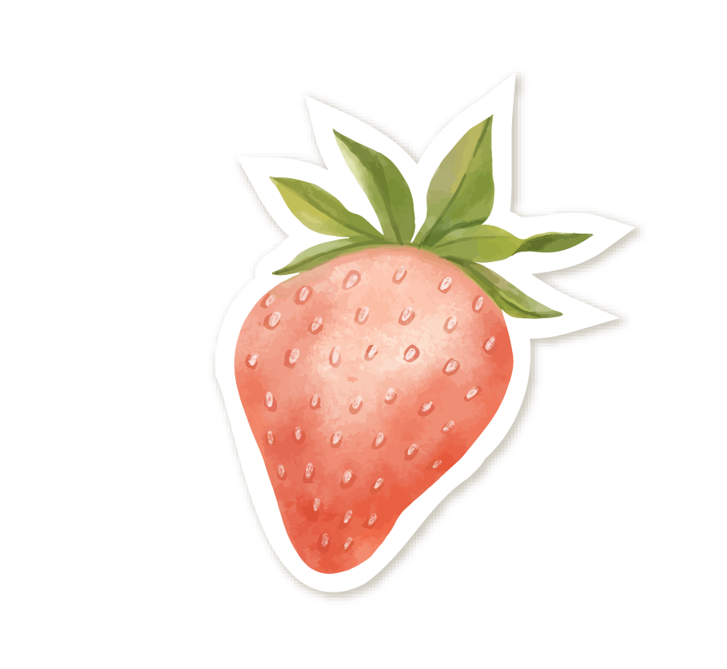
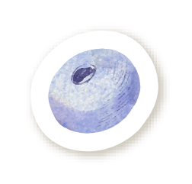
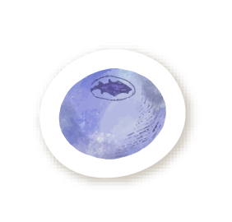
“This is a quote, words full of wisdom that someone important said and can make the reader get inspired.”
—SOMEONE FAMOUS

Slide 9
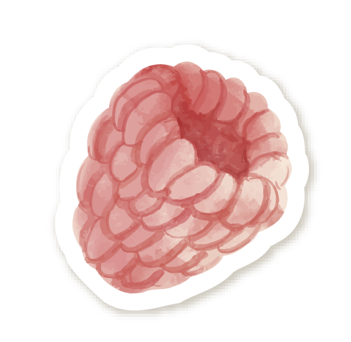
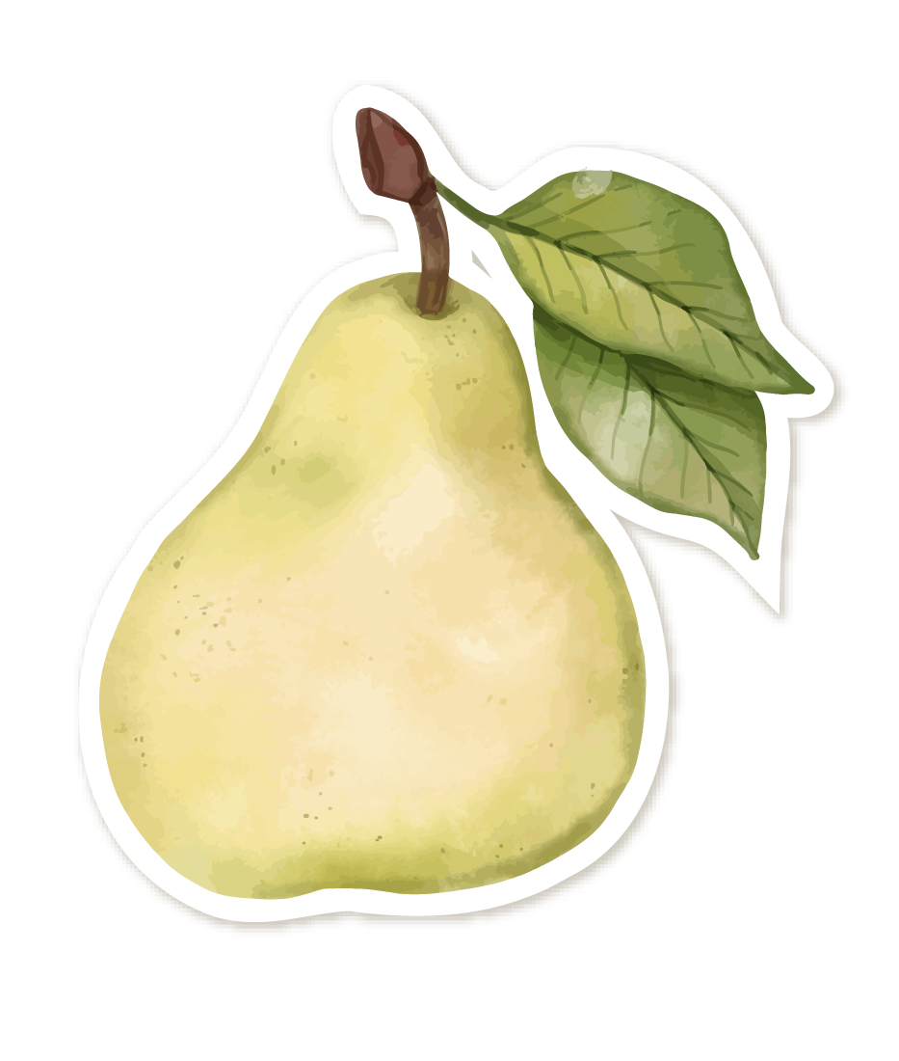
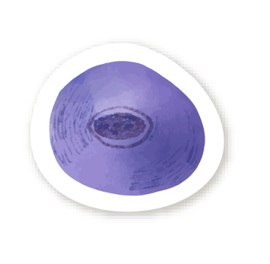
WHAT IS THIS TOPIC ABOUT?
Do you know what helps you make your points clear?
Lists like this one:
They’re simple
You can organize your ideas clearly
You’ll never forget to buy milk!
And the most important thing: the audience won’t miss the point of your presentation

Slide 10
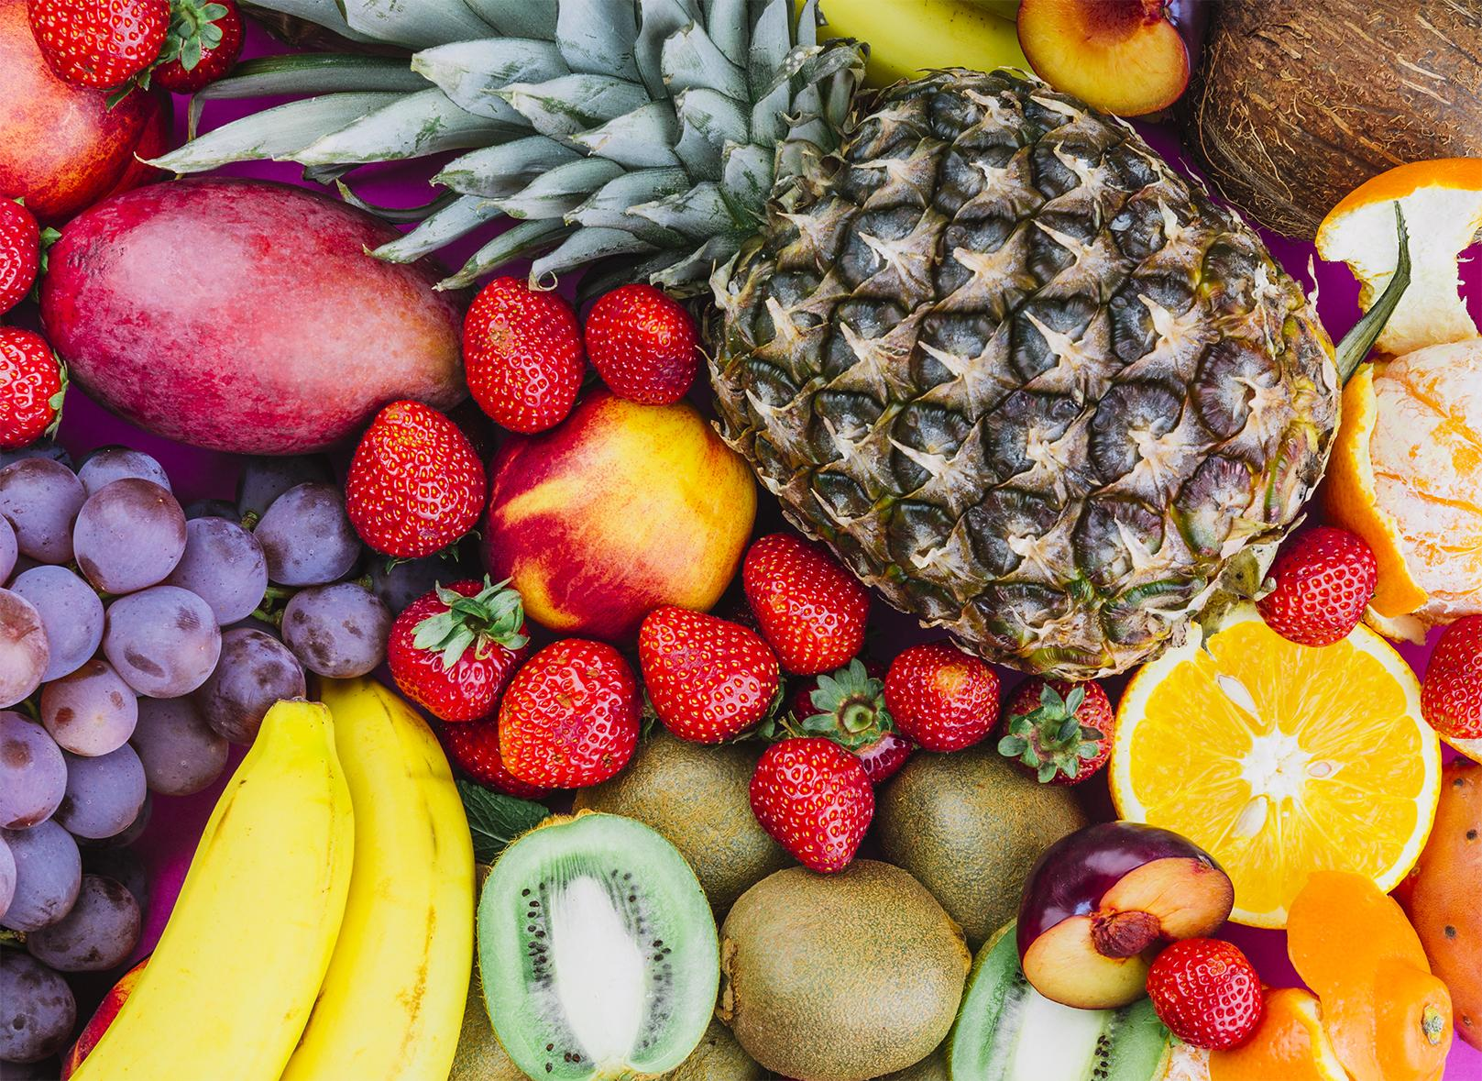
ABOUT THE PRODUCT
Mercury is the closest planet to the Sun and the smallest one in the Solar System—it’s only a bit larger than the Moon. The planet’s name has nothing to do with the liquid metal since it was named after the Roman messenger god

Slide 11


567,890
Big numbers catch your audience’s attention

Slide 12
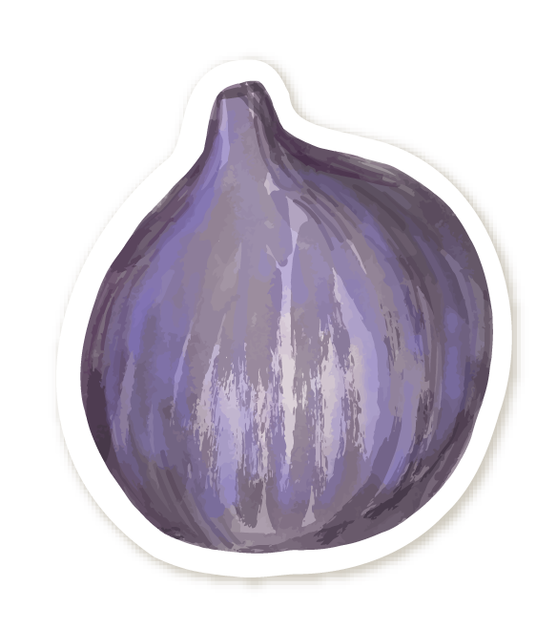
CORE VALUES
Venus
Neptune
Mars
Jupiter
Venus has a beautiful name, but also high temperatures
Neptune is the fourth-largest planet in the Solar System
Despite being red, Mars is actually a very cold place
Jupiter is a gas giant and the biggest planet in the Solar System

Slide 13
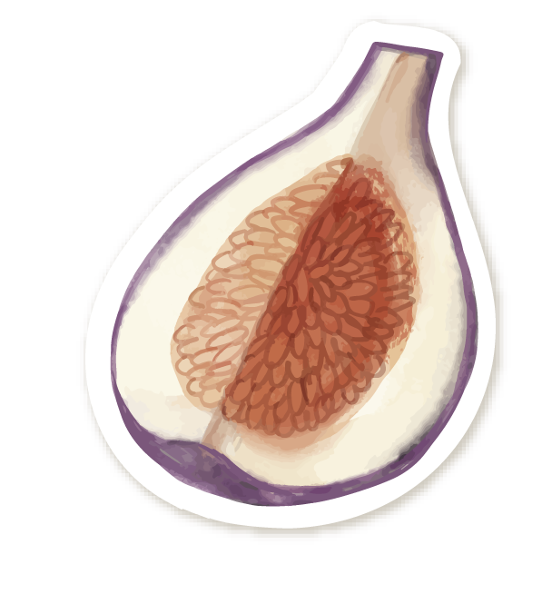
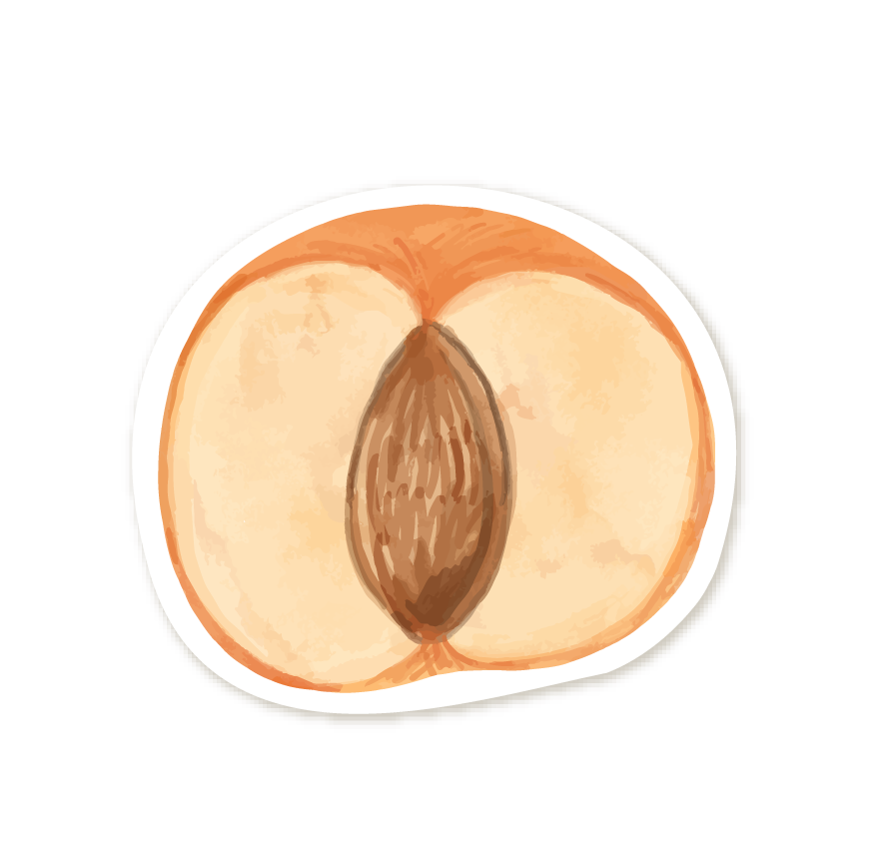
WHAT SETS US APART?
Mercury
Saturn
Mercury is the closest planet to the Sun and the smallest of them all
Saturn is composed mostly of hydrogen and also helium

Slide 14

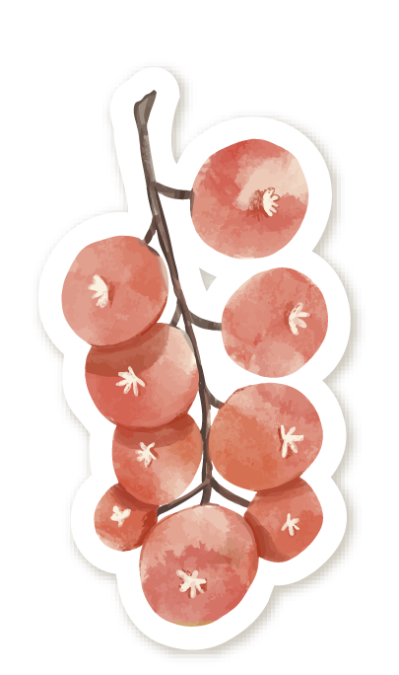
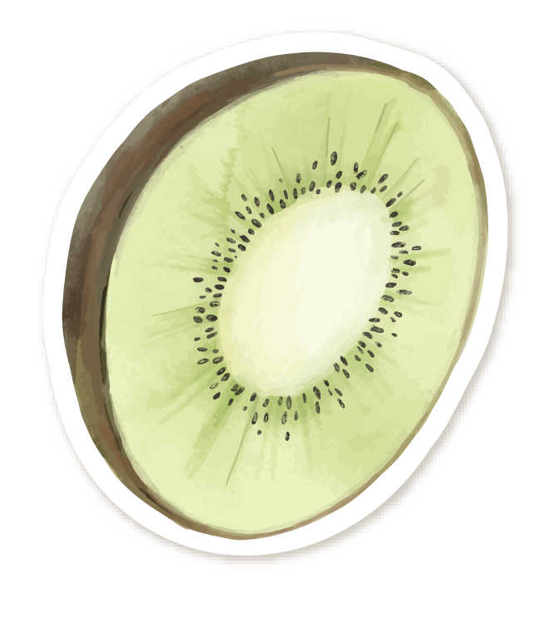
OUR GOALS
Mercury
Saturn
Neptune
Mercury is the closest planet to the Sun and the smallest of them
Saturn is composed mostly of hydrogen and helium
Neptune is the fourth-largest planet in the Solar System

Slide 15
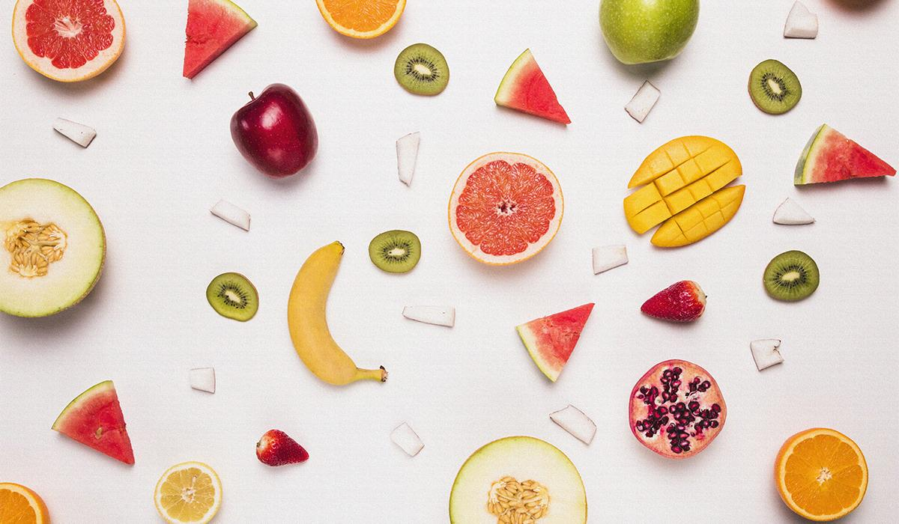
A Picture Is Worth a Thousand Words

Slide 16
PROMOTION
Multimedia
Mailing
Mobile app
Social media
Press
Radio
Mercury is the closest planet to the Sun
It’s composed mostly of hydrogen and helium
Neptune is the farthest planet from the Sun
It’s the second planet from the Sun
Despite being red, Mars is actually a cold
Jupiter is a gas giant and the biggest planet

Slide 17
03.
GOAL STRATEGY
You can enter a subtitle here if you need it

Slide 18
PRODUCT DESCRIPTION
Venus
Neptune
Mars
Jupiter
Venus has a beautiful name and is the second planet from the Sun
Neptune is the fourth-largest planet in the Solar System
Despite being red, Mars is actually a cold place full of iron oxide dust
Jupiter is a gas giant and the biggest planet in the Solar System

Slide 19

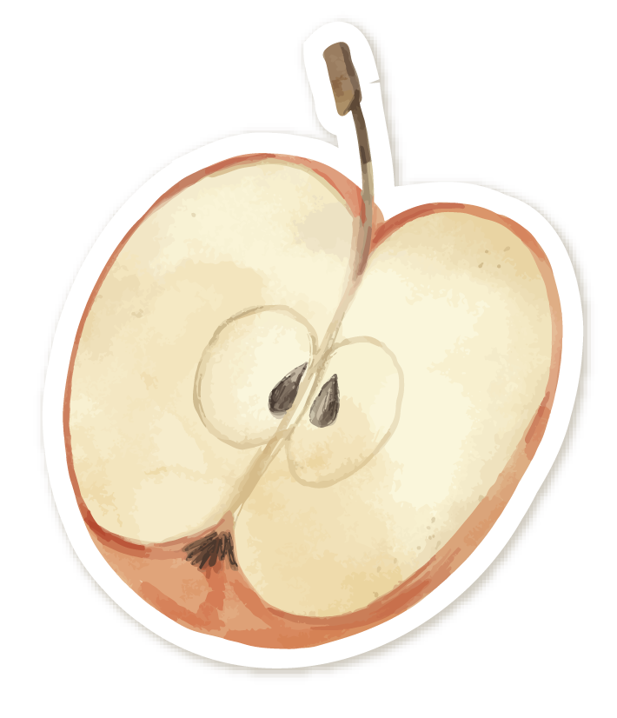

TIMELINE
Mercury is the closest planet from the Sun
Despite being red, Mars is actually a cold place
1992
2000
1996
2006
Venus has a beautiful name, it’s terribly hot
Saturn is a gas giant and has several rings

Slide 20
KEY ACTION ITEMS
First step |  | Second step |  | Third step
Monday | Tuesday | Wednesday | Thursday | Friday | Saturday
Mercury is the smallest planet in the Solar System | Saturn is composed of hydrogen and also helium | Neptune is the farthest planet from the Sun. It’s an ice giant! | Despite being red, Mars is actually a cold place | Jupiter is a gas giant and the biggest planet | Venus is the second planet from the Sun. It’s terribly hot!

Slide 21

AWESOME WORDS

Slide 22
OUR LOCATION
Mars
Despite being red, Mars is a cold place. It’s full of iron oxide dust
Mercury
Mercury is the closest planet to the Sun and the smallest one

Slide 23
SCHEDULE
MAY
JUNE
JULY
AUG
SEP
OCT
NOV
Strawberries
Blueberries
Peaches
Apples

Slide 24
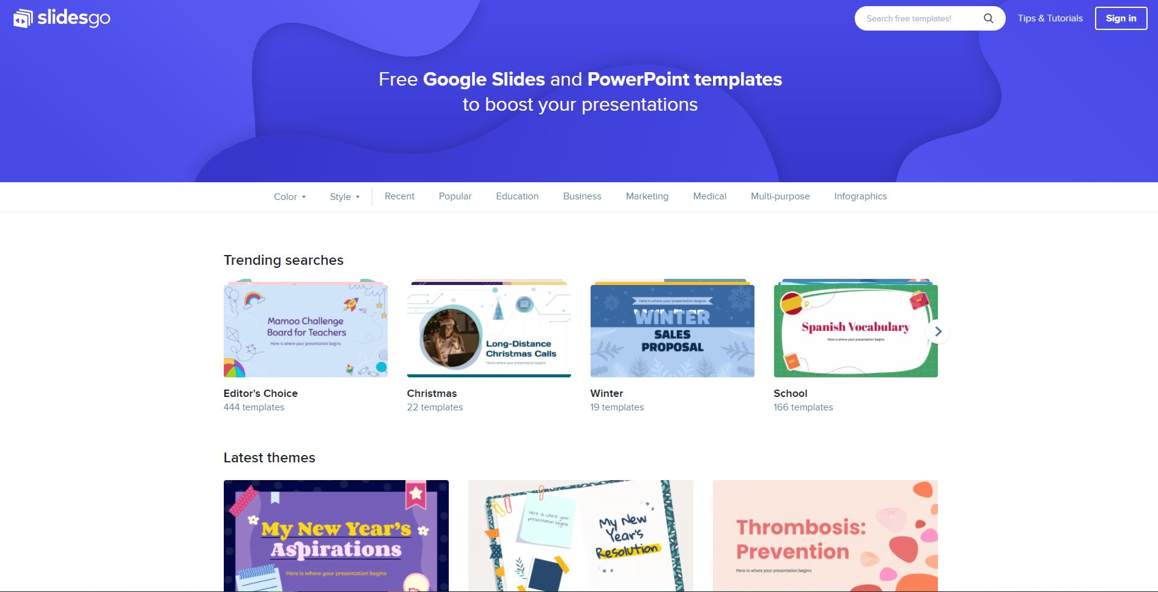
DESKTOP
MOCKUP
You can replace the image on the screen with your own work. Just delete this one, add yours and center it properly

Slide 25
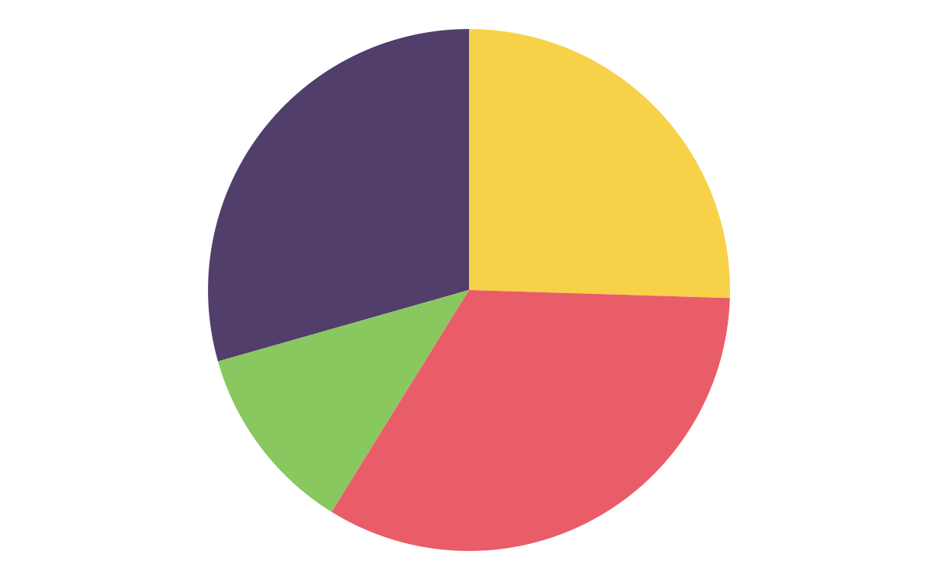
MARKET SHARE
30%
26%
Venus
Jupiter
Venus has a beautiful name
Jupiter is the biggest planet
Saturn
Mars
Saturn is the ringed planet
Despite being
red, it is cold
10%
34%
Follow the link in the graph to modify its data and then paste the new one here. For more info, click here

Slide 26
BUYER PERSONA PROFILE
Wants Privacy
Interests
Blocks ads
Healthy food
Doesn’t share location
Climate change
Shopping Choices
Likely Profiles
Mercury
Venus
Neptune

Slide 27
GUIDING PRINCIPLES
Goal analysis
Buyers’ age
Buyers’ tastes
Buyers’ economy
First objective
Second objective

Slide 28
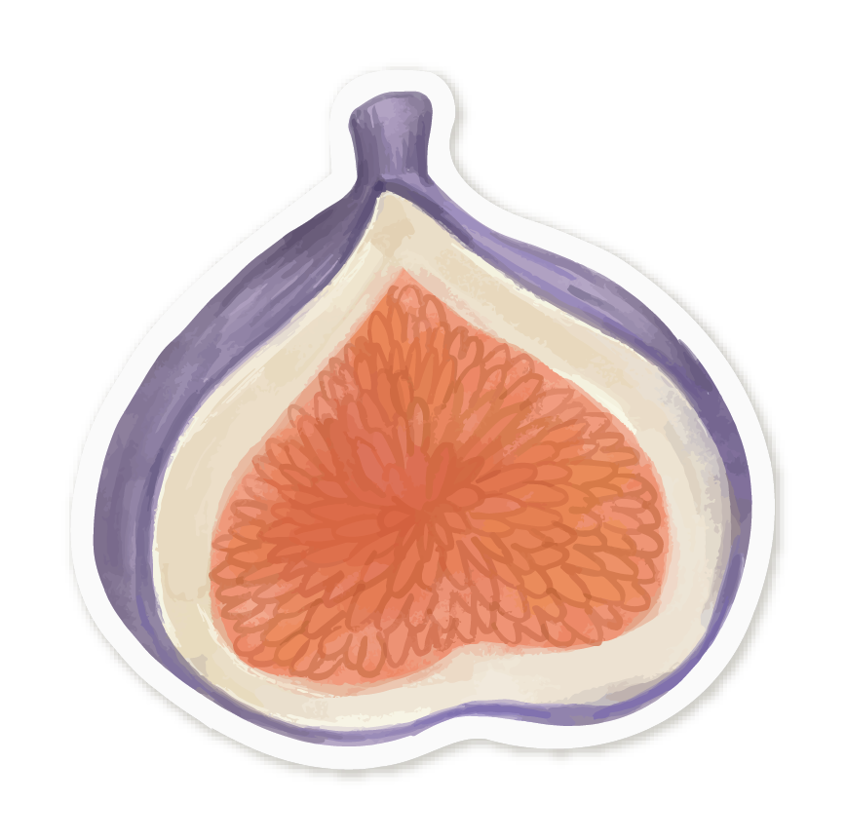
BUYER JOURNEY
Awareness
Consideration
Decision
Mercury is the closest planet to the Sun and the smallest one
Saturn is composed mostly of hydrogen and helium
Neptune is the fourth-largest planet in the Solar System

Slide 29
SALES FUNNEL
Awareness
Venus has a beautiful name
Interest
Mercury is the smallest planet
Decision
Saturn is a gas giant and has rings
Purchase
Despite being red, Mars is cold

Slide 30
COMPETITOR ANALYSIS
25%
50%
35%
Mercury is the closest planet to the Sun and the smallest one
Saturn is composed mostly of hydrogen and also helium
Neptune is the fourth-largest planet in the Solar System

Slide 31
SWOT ANALYSIS
Strengths
Weaknesses
Opportunities
Threats
S
W
Venus has a beautiful name and is the second planet
Despite being red, Mars is actually a very cold place
O
T
Neptune is the fourth-largest planet in the Solar System
Jupiter is a gas giant and the biggest planet in the Solar System

Slide 32
GOALS
Short Term
Long Term
Goal 1
Goal 2
Goal 3
Goal 4
Jupiter is the biggest planet
Saturn is a gas giant and has rings
Despite being red, Mars is a cold
Mercury is the smallest planet

Slide 33
STRATEGY
Goal 1
Earth is where we live on
Key action 1
Key action 2
Jupiter is the biggest planet
Saturn is the ringed planet
Mars is actually a cold place
Mercury is the smallest planet

Slide 34
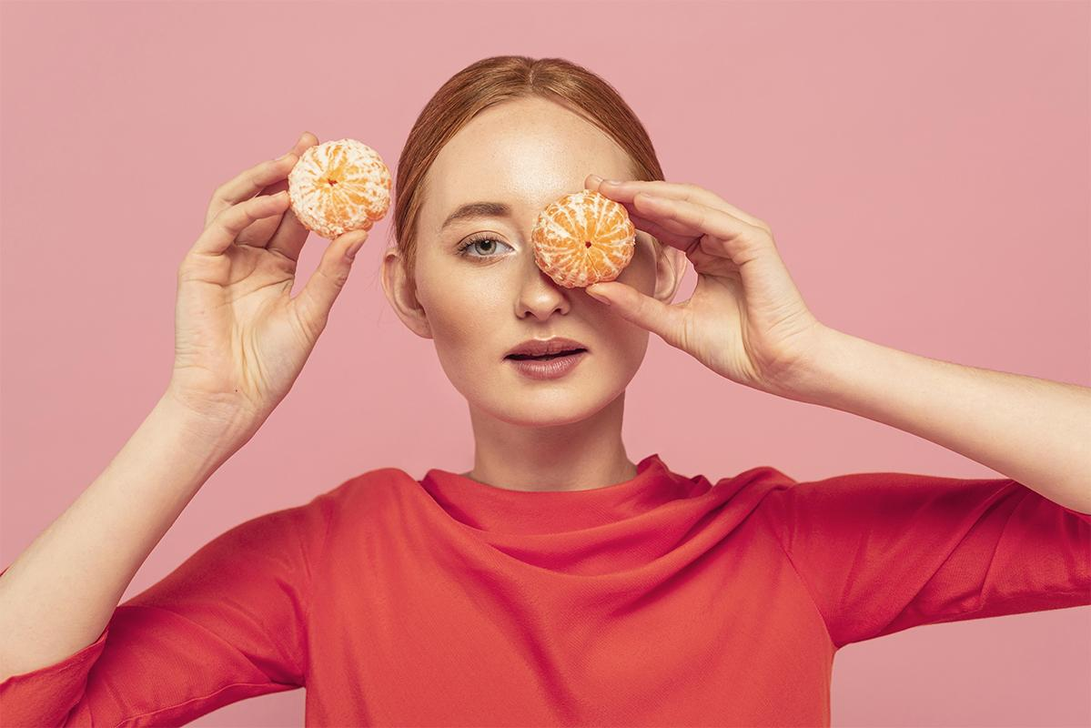
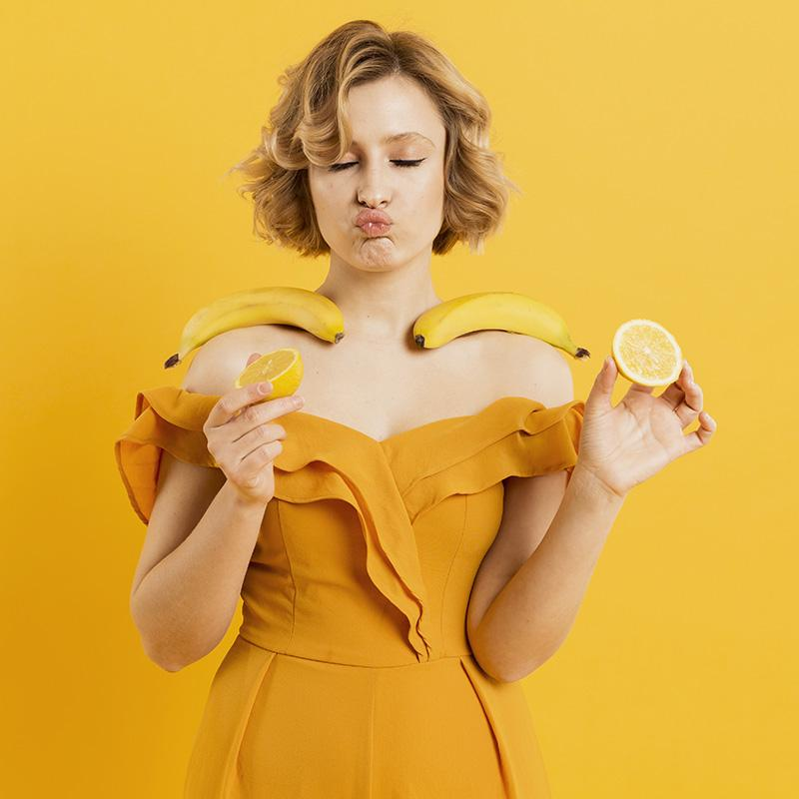
OUR TEAM
HELENA JAMES
JENNA DOE
You can replace the
image on the screen
with your own
You can replace the
image on the screen
with your own

Slide 35
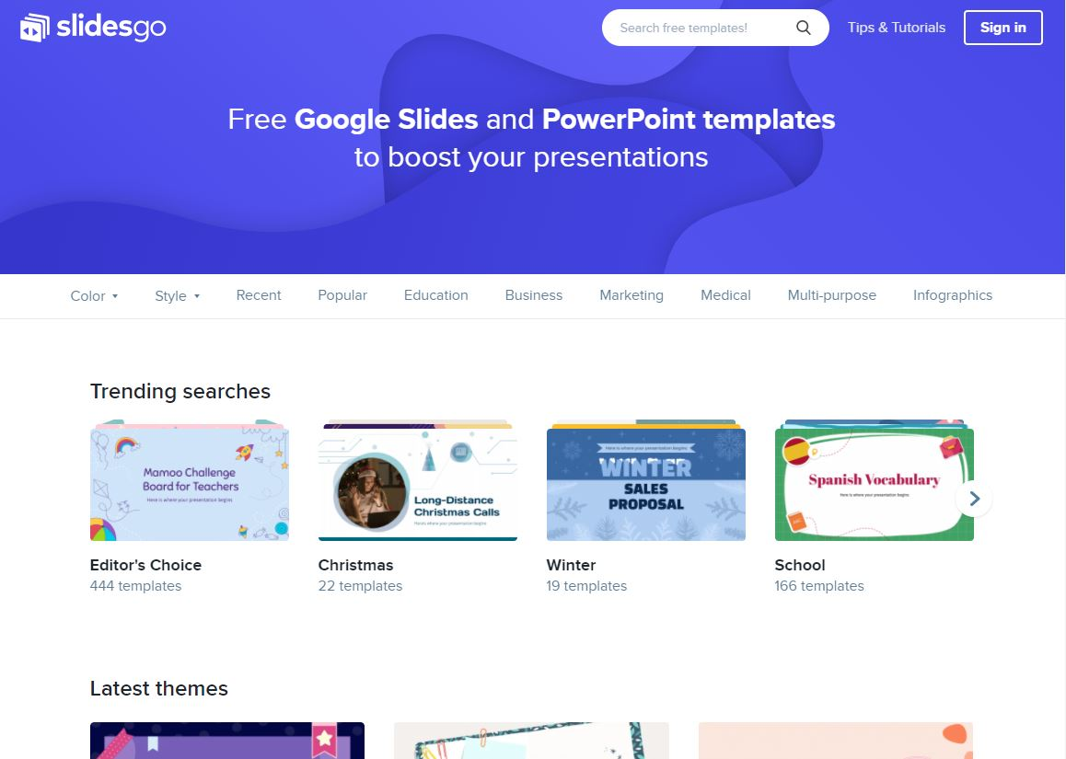
TABLET
MOCKUP
You can replace the image on the screen with your own work. Just delete this one, add yours and center it properly

Slide 36
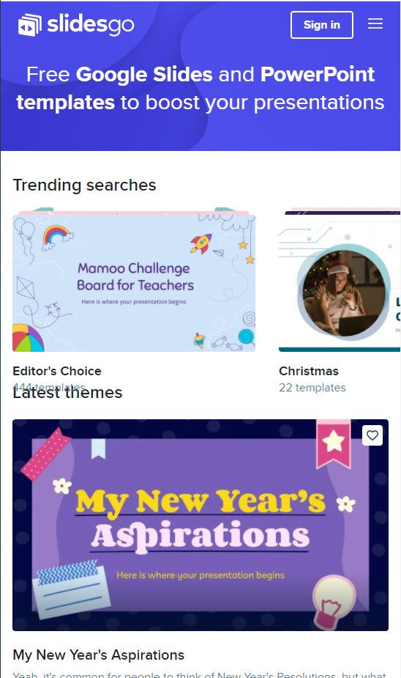
PHONE
MOCKUP
You can replace the image on the screen with your own work. Just delete this one, add yours and center it properly

Slide 37
Thanks!
Do you have any questions?
youremail@freepik.com
+91 620 421 838
yourcompany.com
Please keep this slide for attribution.

Slide 38
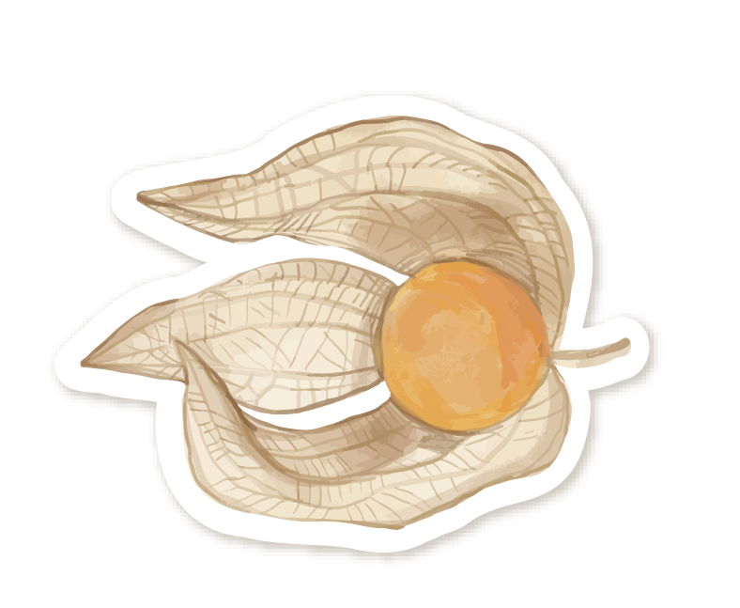

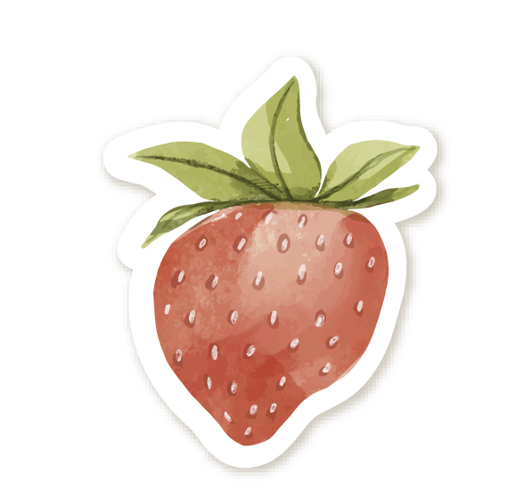
ALTERNATIVE RESOURCES

Slide 39
ALTERNATIVE RESOURCES
Vectors
Hand painted watercolor fruit collection
Collection of different fruits illustrated
Hand painted watercolor fruit collection
Hand painted watercolor fruit collection
Photos
Cute woman recording with fruits
Medium shot woman holding fruit
Set of fruits, seeds and leaves

Slide 40
RESOURCES
Vectors
Hand painted watercolor fruit collection
Hand painted watercolor fruit collection
Hand painted watercolor fruit collection
Canvas texture
Photos
Grapes; strawberries; pineapple; kiwi; apricot; banana and whole pineapple
Different abstract slices of tropic fruits
Woman holding bananas lemon
Woman covering her eyes with oranges Free Photo

Slide 41
Instructions for use
In order to use this template, you must credit Slidesgo by keeping the Thanks slide.
You are allowed to:
- Modify this template.
- Use it for both personal and commercial projects.
You are not allowed to:
- Sublicense, sell or rent any of Slidesgo Content (or a modified version of Slidesgo Content).
- Distribute Slidesgo Content unless it has been expressly authorized by Slidesgo.
- Include Slidesgo Content in an online or offline database or file.
- Offer Slidesgo templates (or modified versions of Slidesgo templates) for download.
- Acquire the copyright of Slidesgo Content.
For more information about editing slides, please read our FAQs or visit Slidesgo School:
https://slidesgo.com/faqs and https://slidesgo.com/slidesgo-school

Slide 42
Instructions for use (premium users)
In order to use this template, you must be a Premium user on Slidesgo.
You are allowed to:
Modify this template.
Use it for both personal and commercial purposes.
Hide or delete the “Thanks” slide and the mention to Slidesgo in the credits.
Share this template in an editable format with people who are not part of your team.
You are not allowed to:
Sublicense, sell or rent this Slidesgo Template (or a modified version of this Slidesgo Template).
Distribute this Slidesgo Template (or a modified version of this Slidesgo Template) or include it in a database or in any other product or service that offers downloadable images, icons or presentations that may be subject to distribution or resale.
Use any of the elements that are part of this Slidesgo Template in an isolated and separated way from this Template.
Register any of the elements that are part of this template as a trademark or logo, or register it as a work in an intellectual property registry or similar.
For more information about editing slides, please read our FAQs or visit Slidesgo School:
https://slidesgo.com/faqs and https://slidesgo.com/slidesgo-school

Slide 43
Fonts & colors used
This presentation has been made using the following fonts:
Chelsea Market
(https://fonts.google.com/specimen/Chelsea+Market)
Work Sans
(https://fonts.google.com/specimen/Work+Sans)
#513e6b
#e95d68
#f7d248
#89c75f
#ffedaaff
#ffffffff

Slide 44





Storyset
Create your Story with our illustrated concepts. Choose the style you like the most, edit its colors, pick the background and layers you want to show and bring them to life with the animator panel! It will boost your presentation. Check out How it Works.
Pana
Amico
Bro
Rafiki
Cuate

Slide 45
Use our editable graphic resources...
You can easily resize these resources without losing quality. To change the color, just ungroup the resource and click on the object you want to change. Then, click on the paint bucket and select the color you want. Group the resource again when you’re done. You can also look for more infographics on Slidesgo.

Slide 48
JANUARY
FEBRUARY
MARCH
APRIL
MAY
JUNE
PHASE 1
Task 1
Task 2
PHASE 2
Task 1
Task 2
JANUARY
FEBRUARY
MARCH
APRIL
PHASE 1
Task 1
Task 2

Slide 51
...and our sets of editable icons
You can resize these icons without losing quality.
You can change the stroke and fill color; just select the icon and click on the paint bucket/pen.
In Google Slides, you can also use Flaticon’s extension, allowing you to customize and add even more icons.

Slide 52
Educational Icons
Medical Icons

Slide 53
Business Icons
Teamwork Icons

Slide 54
Help & Support Icons
Avatar Icons

Slide 55
Creative Process Icons
Performing Arts Icons

Slide 56
Nature Icons

Slide 57
SEO & Marketing Icons

Slide 58


